Slide 1
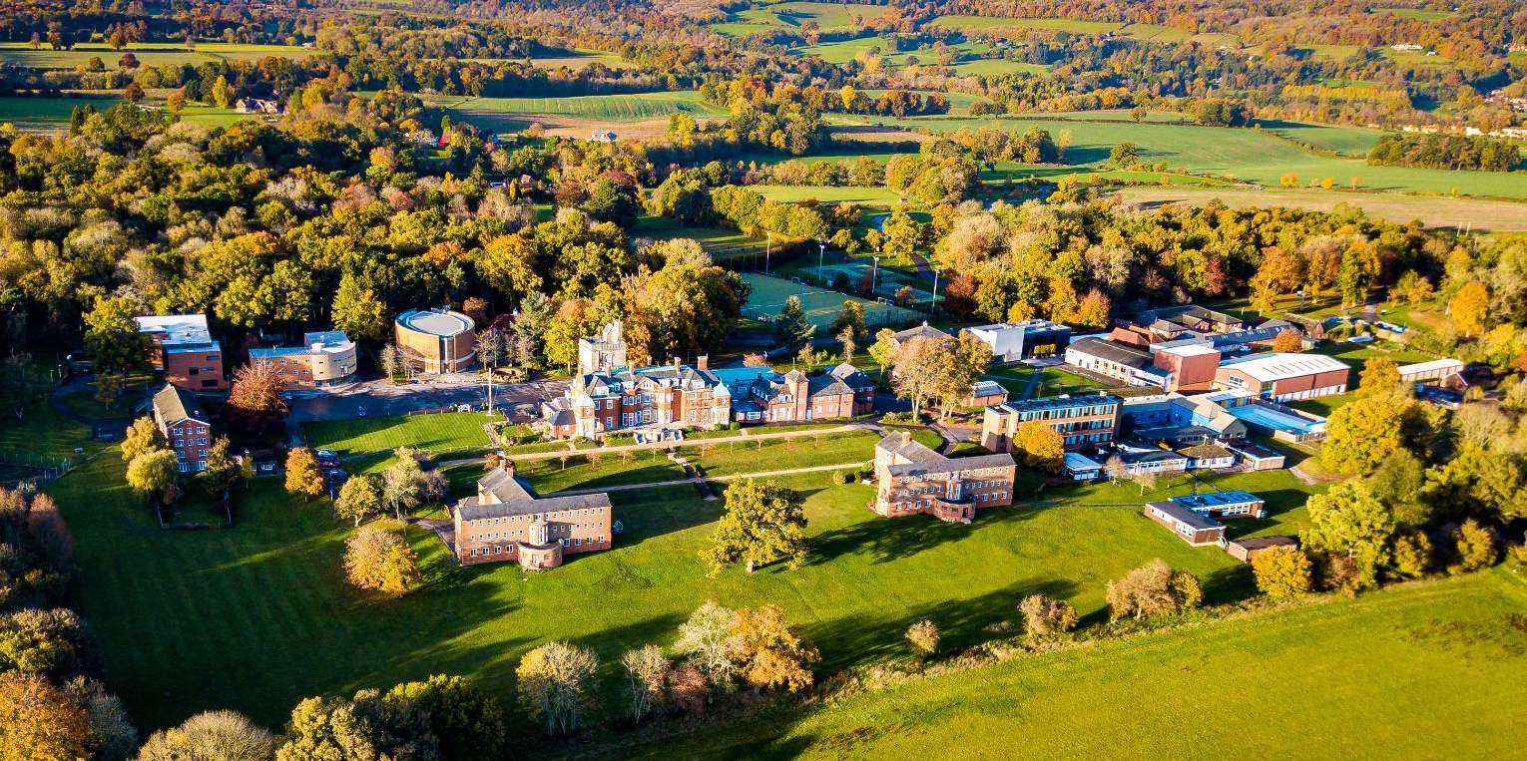


Candidate Pack
Teacher of Music

Slide 2
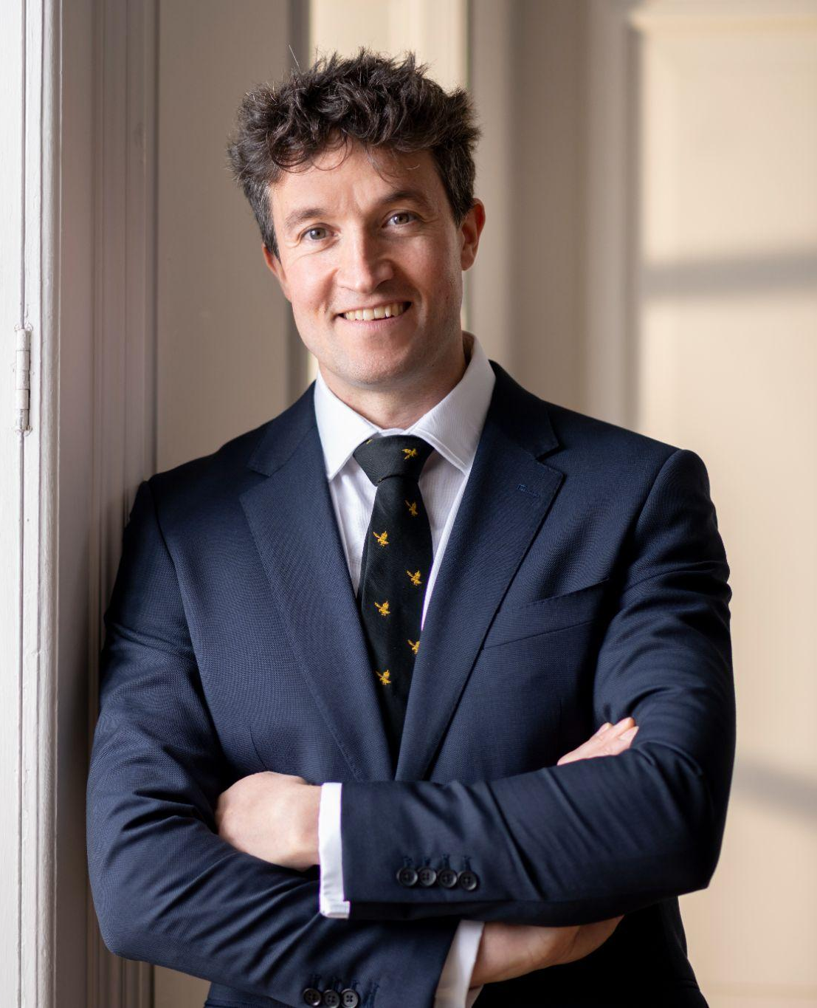

Mr Oliver Knight - Head
I joined Pangbourne in September 2024 and have had the pleasure of working with an incredibly talented and dedicated staff and Board of Governors to drive forward my vision for the school.
Pangbourne is my fourth headship and all three of my previous headships were at inner-London state schools which I transformed by driving up the educational standards. I am passionate about bringing the best from the state sector and combining it with the independent school model to ensure the best possible education and opportunities for all pupils at Pangbourne.
My two passions in life are education and the outdoors. Pangbourne enables me to combine these into the uniqueness of a Pangbournian education through access to our world-class adventure facilities set within our 230 acre site. This enables us to create an academic ethos underpinned by an adventurous spirit; where risk, failure and uncertainty are daily experiences.
It is no longer enough for pupils to just achieve great academic outcomes. As staff, we work together to ensure that pupils are prepared for not just success in school but also success in life. Our aim is to educate pupils to be a force for good in an imperfect world.
I am in the process of implementing our Campus 2030 plans and would be delighted if you applied to join me on this exciting journey for the future vision of the College .
With best wishes
Mr Oliver Knight, Head

Slide 3
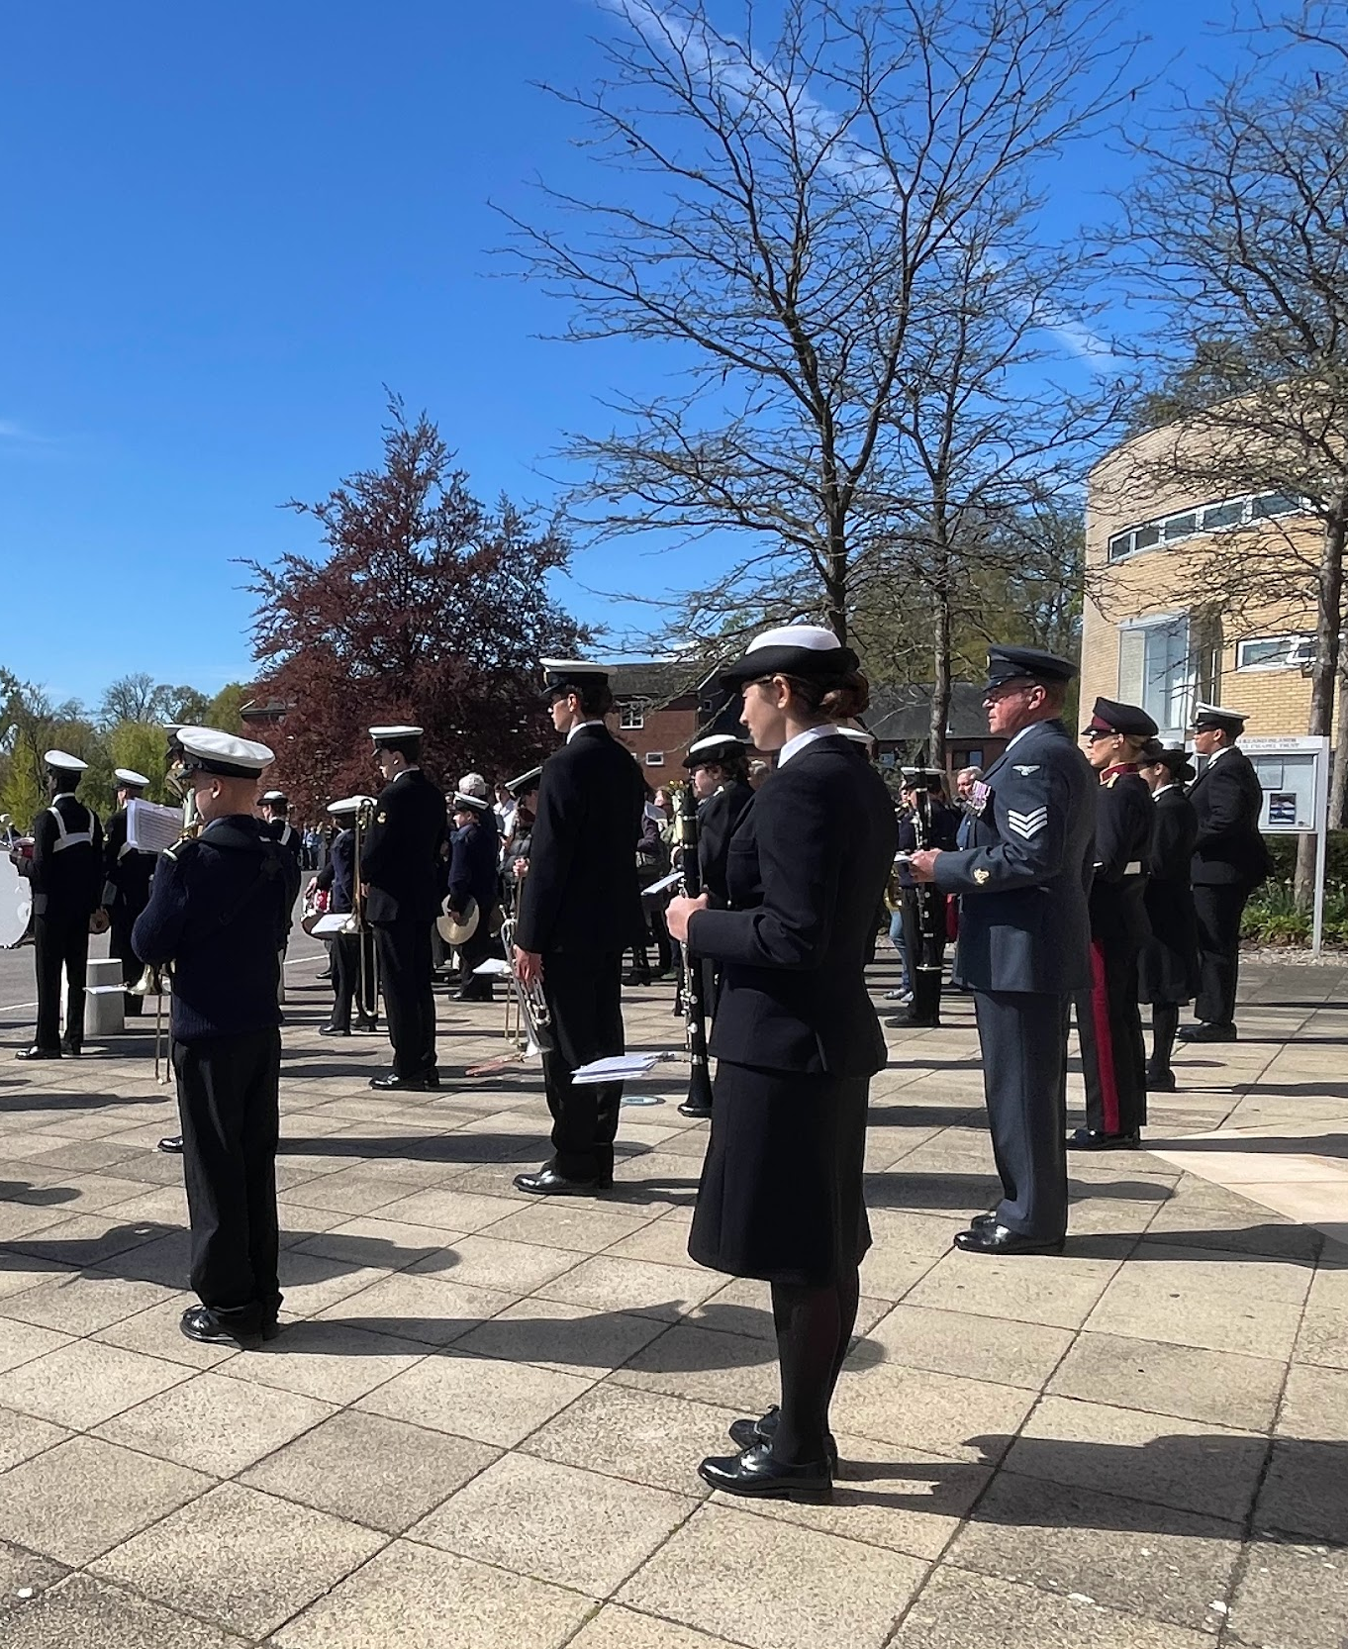
About Pangbourne
With over 30 years of co-educational experience, Pangbourne College is an independent day and boarding school for girls and boys aged 11-18 years, set in over 230 acres of Berkshire’s Area of Outstanding Natural Beauty, with the best four mile stretch of rowing river in the country.
There are four pillars that develop and sustain a Pangbourne education: Academic Rigour, Exploration, Community and Leadership. These four components ensure all our students develop the attitudes, skills and behaviours that underpin success at school and in life. We empower each individual to fulfil their potential and develop the confidence, values and skills to make a positive difference to the world.
Pangbourne was established in 1917 as ‘The Nautical College, Pangbourne’ with a vision to train boys to become Merchant Navy Officers. In 1969 the College adopted the name it has today and shifted its focus to an academic education, becoming fully co-educational in 1996. Pangbourne College is not a military school and only two or three of our leavers each year go into the armed forces, but we do proudly pay tribute to our naval roots through preserving a number of traditions.
The eight Flag Values of Kindness, Resilience, Selflessness, Moral Courage, Integrity, Initiative, Industry and Respect underpin everything we do as a nurturing, pupil-centred community.

Slide 4

Pangbourne on a page
Pupils on roll 400
6th Form Results 2025
45% A* - A
+0.7 Value Added
92% First Choice University
GCSE Results 2025
38% 9 - 7
84% 9 - 5
+0.72 Value Added
Performance Sports
Girls’ hockey
Boys’ rugby
Boys’ and girls’ rowing
Equestrian
Competitive Sports
Boys’ and girls’ football
Boys’ and girls’ cricket
Boys’ and girls’ tennis

Slide 5
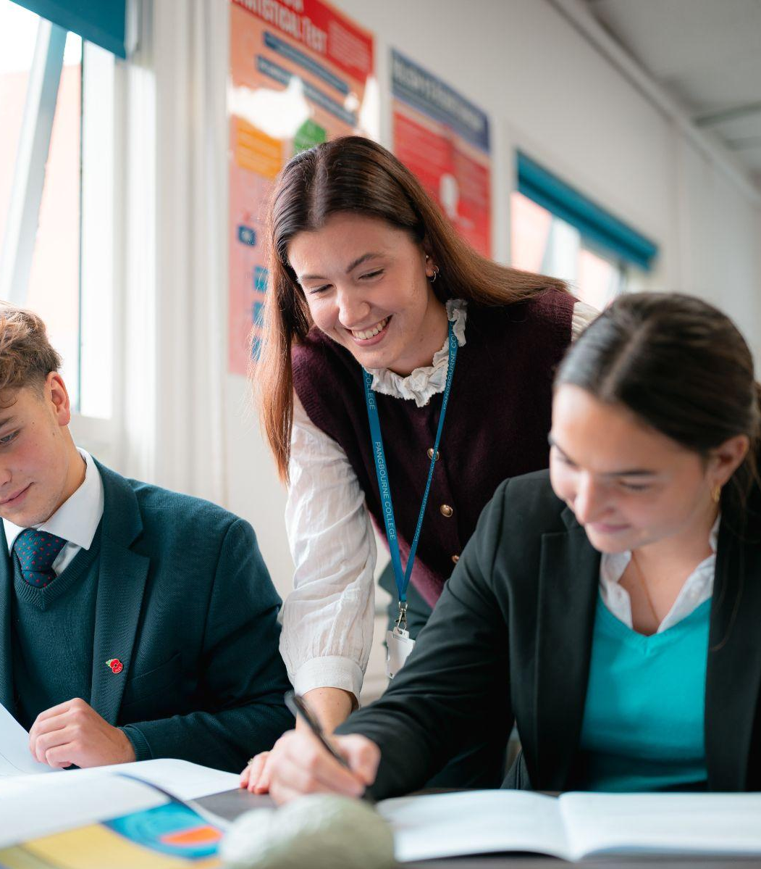
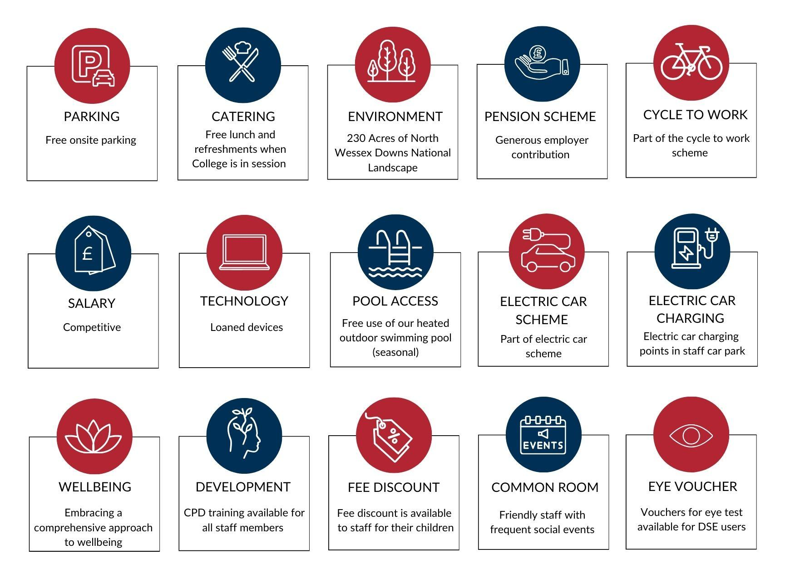
Employee benefits

Slide 6
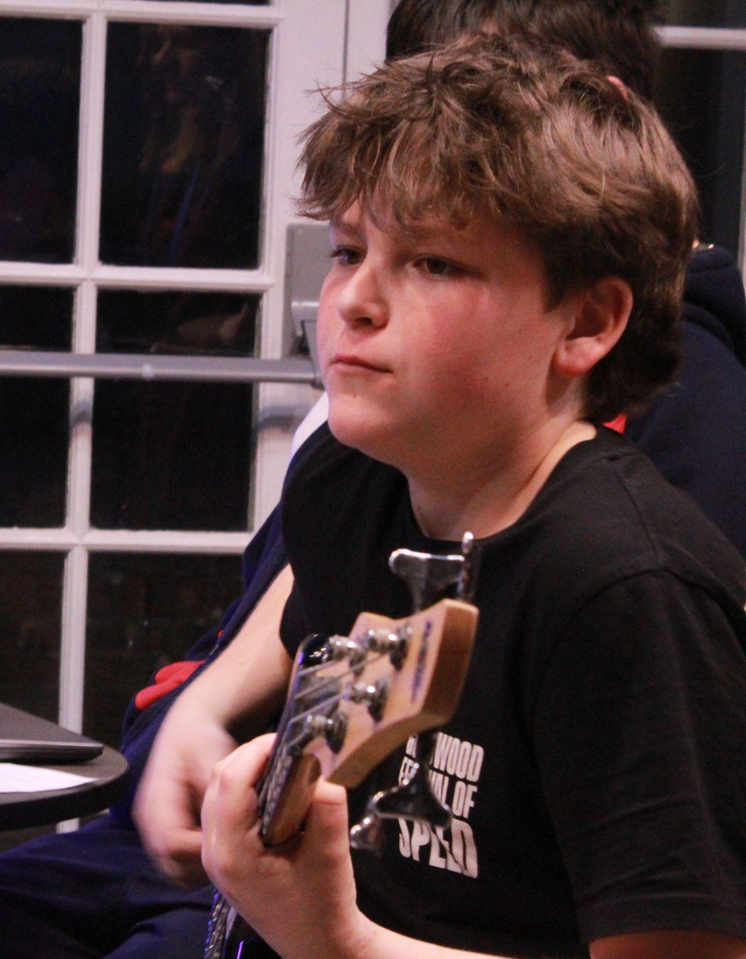
About the role
TEACHER OF MUSIC
Start Date: SEPTEMBER 2026
Contract Type: Permanent
Hours: Full time
Core Hours: 08.15 – 17.45 Monday to Friday
Saturday: There are no academic lessons on a Saturday, however the Music School is open for practice on a Saturday morning and Thursday evening, staffed on rotation. Co-curricular involvement is essential and will be reflected with a reduction in teaching load.
Salary: Competitive. Our salary package will recognise
your experience, qualifications and commitment.
Reporting To: Director of Music
Key working relationships: Members of the Music Department Senior Management Teaching Staff Pupils, Parents and Guardians

Slide 7
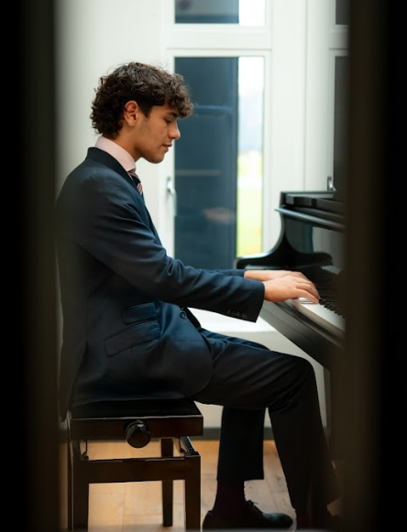
Department overview
MUSIC
At Pangbourne, musicians of all abilities have the opportunity to explore and develop their musical interests beyond the classroom. The Music Department organises regular trips to hear world-class musicians perform, inspiring pupils to deepen their passion for music. We also encourage participation in a wide range of ensembles, including the College Choir, Chamber Choir, Jazz Band, Marching Band, Corps of Drums, and various chamber groups. The whole school comes together every Friday afternoon for Congers—our weekly hymn practice and fun singing session—as a great way to round off the week.
There are three full-time members of staff within the Music School, all with different areas of specialism. The strong Naval traditions of the College are represented through our Marching Band, led by our Bandmaster who is also our Music Operations Manager.
Our ensembles perform regularly, from informal events in the 6th Form Cafe to prestigious events in the Nancye Harding Recital Hall and the Falkland Islands Memorial Chapel. A particular highlight is our annual invitation to perform at the National Service for Seafarers at St Paul’s Cathedral—a privilege we deeply cherish.
The Inter-Divisional Music Competition and the candlelit Service of Nine Lessons and Carols are key moments in the Pangbourne calendar, fostering both camaraderie and musical excellence.
Whether through performance, competition, or community engagement, music at Pangbourne seeks to provide an enriching and inspiring experience for all.

Slide 8
Key Responsibilities
Leadership responsibilities:
Overtly and proactively support the department’s vision and values to pupils, parents and the wider community.
(If also Assistant Director of Music) Contribute to the appraisal of teachers responsible for teaching music in conjunction with the Director of Music.
(If also Assistant Director of Music) Create and update departmental schemes of work, preparing and developing courses of study and sharing resources with colleagues.
(If also Assistant Director of Music) Manage a designated budget, in conjunction with the Director of Music.
Manage appropriate risk assessments for any activities they are leading, in conjunction with the Director of Music.
Curriculum and delivery:
(If also Assistant Director of Music) Act as lead teacher for either GCSE, completing all required aspects of administration and exam preparation.
Prepare and deliver music programmes from Key Stage 3 to 6th Form, ensuring schemes of work are regularly updated.
Prepare elective exam groups for external qualifications at both Key Stage 4 and in the 6th Form.
Regularly mark pupils’ classwork and prep in line with the school marking policy for music examination courses.
Ensure that individual learning needs are met through appropriate use of differentiation.
Communication:
Build and maintain positive relationships with parents and to communicate regularly regarding pupils’ learning and progress.
Lead the promotion of Music at Pangbourne both externally and internally.
Liaise with the school’s Marketing department in order to promote the department.

Slide 9
General teaching
Duties and responsibilities of all teachers:
Adopting the Pangbourne Teacher Habits to maintain an evidence-led model of instruction.
Following the appropriate schemes of work.
Maintaining discipline within their classroom and the department.
Regular setting of class work and preps.
Regular marking and assessment of students’ work
Maintaining records of lessons taught and students’ marks.
Meeting assessment and reporting deadlines.
Attending parents’ meetings.
Running academic support clinics.
Setting appropriate work in the case of absence.
Maintaining classroom equipment.
Maintaining good quality classroom displays and contributing to departmental display areas.
Supporting and helping other members of the department.
Attending INSET or courses for professional development and generally keeping up to date with the subject and current developments/teaching techniques, feeding back to the department where relevant.
Setting and marking internal examinations as agreed.
Involvement in department tours and trips.
Act as a Tutor to a small group (about 10) of pupils.
Willingness to engage in and develop extra-curricular activities
Complying with health and safety issues within the Department, reporting any faults immediately.
Please note:
The above is only an outline of the tasks and responsibilities of the role. The post holder will carry out any other duties as may be reasonably required by his/her line manager. The job description and person specification may be reviewed on an on-going basis in accordance with the changing needs of the department and College. This job description and accompanying documentation do not form part of the employment contract.

Slide 10

Personal specification - essential elements
Qualifications
Relevant degree or equivalent
ECT or QTS
Able to teach KS3, GCSE, and A-level Music
Skills and Special Aptitudes
Choral leadership experience, knowledge and understanding
High-level knowledge of harmony, counterpoint and musical analysis across a broad range of genres
Experience in and willingness to coach ensembles of various styles and sizes
Excellent organisational, communication and interpersonal skills
Ability to link topics across the syllabus
Ability to develop good examination technique in pupils, in particular, drawing out the skills of analysis and evaluation
Ability to ensure that all students and parents have regular feedback on progress
Personal Qualities
Passion and enthusiasm for teaching Music
Ability to relate to teenagers
A desire and capacity to understand the strengths and weaknesses of individual pupils along with the ability to use differentiation in teaching
Capability of maintaining high standards and being excellent practitioners in the classroom
Ability to encourage in students the enjoyment of the subject, and a responsibility for their own learning
A sense of humour and integrity
Special requirements
Promoting and safeguarding the welfare of children
Compliance with Pangbourne College’s Child Protection and Safeguarding Policy
Current driving licence

Slide 11
Personal specification - desirable elements
Skills and Special Aptitudes
High level keyboard skills
Conducting skills, experience and training
Detailed knowledge of examination requirements
Knowledge to link subject content with career opportunities
Ability to use innovative teaching methods
Personal Qualities
Enthusiasm to collaborate with colleagues
Ambition to progress professionally within the subject
Capacity to take calculated risks in teaching
Other shared interests with pupils through house or extra-curricular activities
Self-awareness

Slide 12

How to apply
Download the application form from the website: pangbourne.com/vacanices
Applications should be sent to recruitment@pangbourne.com
Deadline for applications is: 09.00am Tuesday 05 May 2026
Please apply as soon as possible as applications will be considered upon receipt; we reserve the right to interview/appoint before the closing date.
We welcome applications from candidates in either state or independent sectors.
We would be happy to have an informal conversation about the College, the Department and the role. Please contact recruitment@pangbourne.com.
Prospective applicants are encouraged to contact Mrs Nichola Graham, Director of Music (nichola.graham@pangbourne.com) for an informal conversation about the role before applying.

Slide 13
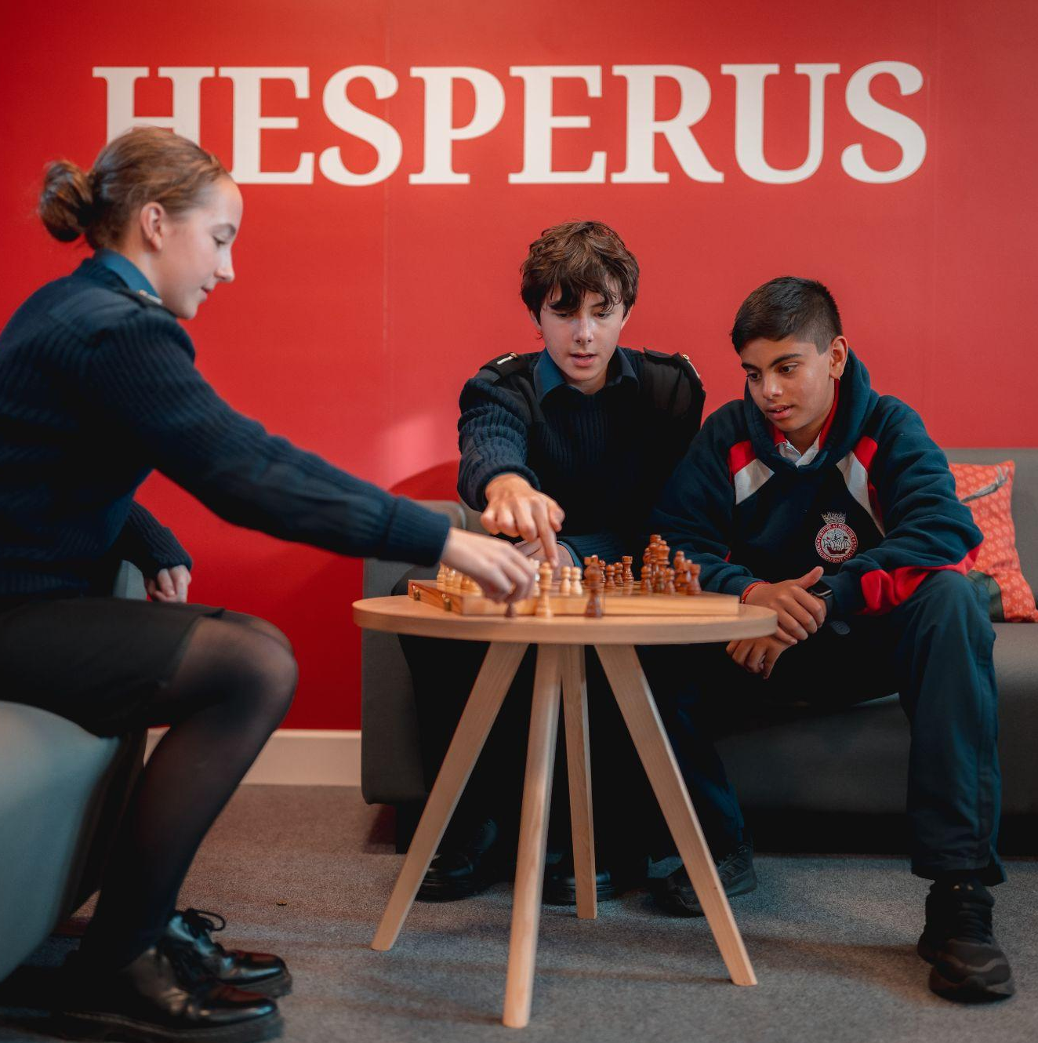
Other information
Child Protection and Safeguarding Policy
In line with our recruitment policy and for the protection of our pupils, you will be subject to an enhanced DBS disclosure and employment reference checks. Pangbourne College is committed to safeguarding and promoting the welfare of children and young people and expects staff and volunteers to share this commitment. You must be eligible to work in the UK.
It is the post holder’s responsibility for promoting and safeguarding the welfare of children. You will comply with the Pangbourne College Child Protection and Safeguarding Policy, and the requirement to report to the Designated Safeguarding Lead any concerns relating to the safety or welfare of children.
Information Security, Confidentiality and Data Protection
During the course of employment the post holder may have access to, see or hear information of a confidential nature and he/she will be required not to disclose such information. All personal identification information must be held in the strictest confidence and should be disclosed only to authorised people in accordance with the General Data Protection Regulation and the College’s Privacy Notice, unless explicit written consent has been given by the person identified.

Slide 14
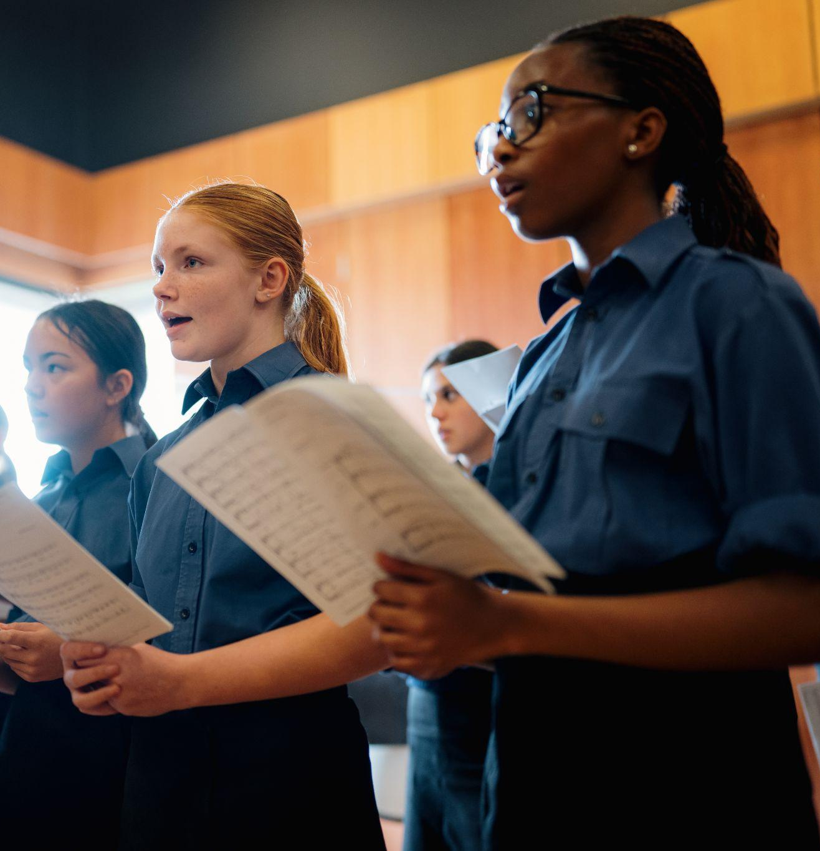
Other information
Equal Opportunities
We are proactively committed to creating a diverse staff body which reflects the community that we teach. At Pangbourne College we value diversity and inclusion; we want to attract the best people for the role available. This is regardless of age, ethnicity, sexual orientation, gender, disability, socioeconomic status or religious beliefs.
The post holder must comply with and promote Equal Opportunities and avoid any behaviour which discriminates against others on the grounds of sex, disability, marital status, sexual orientation, age, race, colour, nationality, ethnic or national origin, religion, political opinion, trade union membership.
Health and Safety Under the Health & Safety at Work etc Act 1974, it is the responsibility of individual employees at every level to take care of their own health and safety and that of others who may be affected by their own acts at work. This includes co-operating with the College and colleagues in complying with Health and Safety obligations to maintain a safe environment.

Slide 15

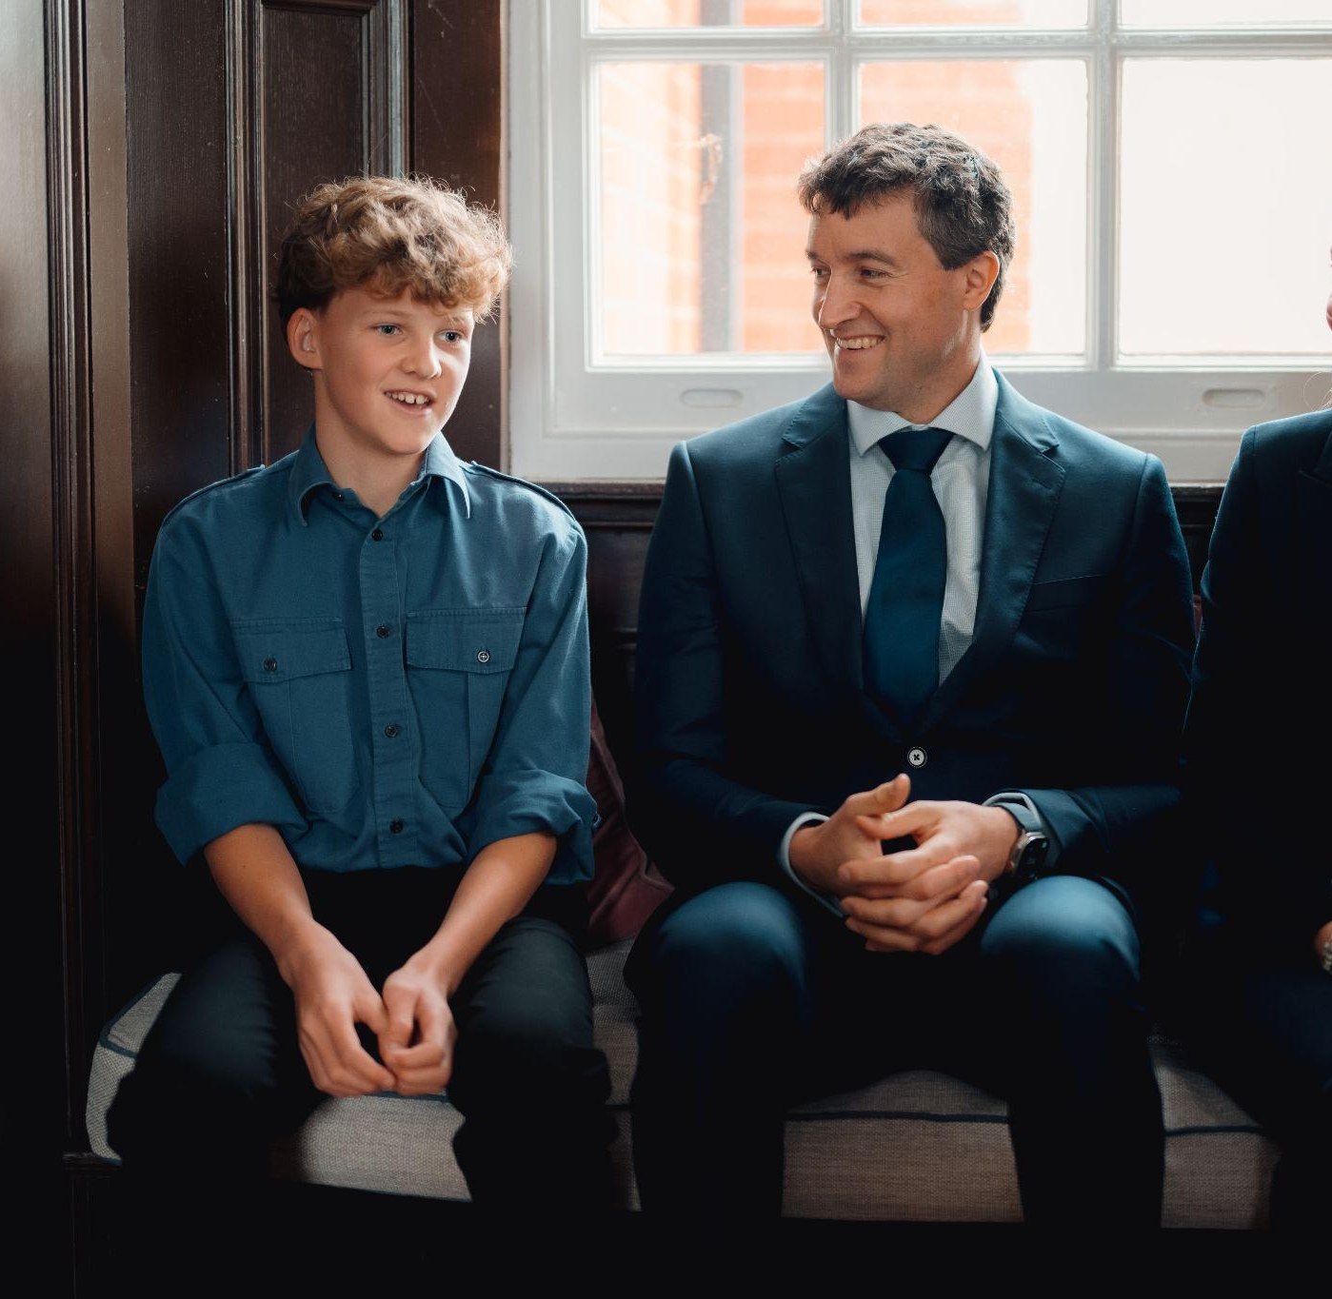
Other information
Terms and Conditions of Service
The post holder will be required to comply with all policies and procedures issued by and on behalf of the College. The post holder will be subject to an Enhanced Disclosure and Barring Service Certificate. The post holder will be required to participate in the College’s appraisal procedures as an appraise and if applicable, as an appraiser. The post holder will be required to attend statutory and mandatory training.

Slide 16
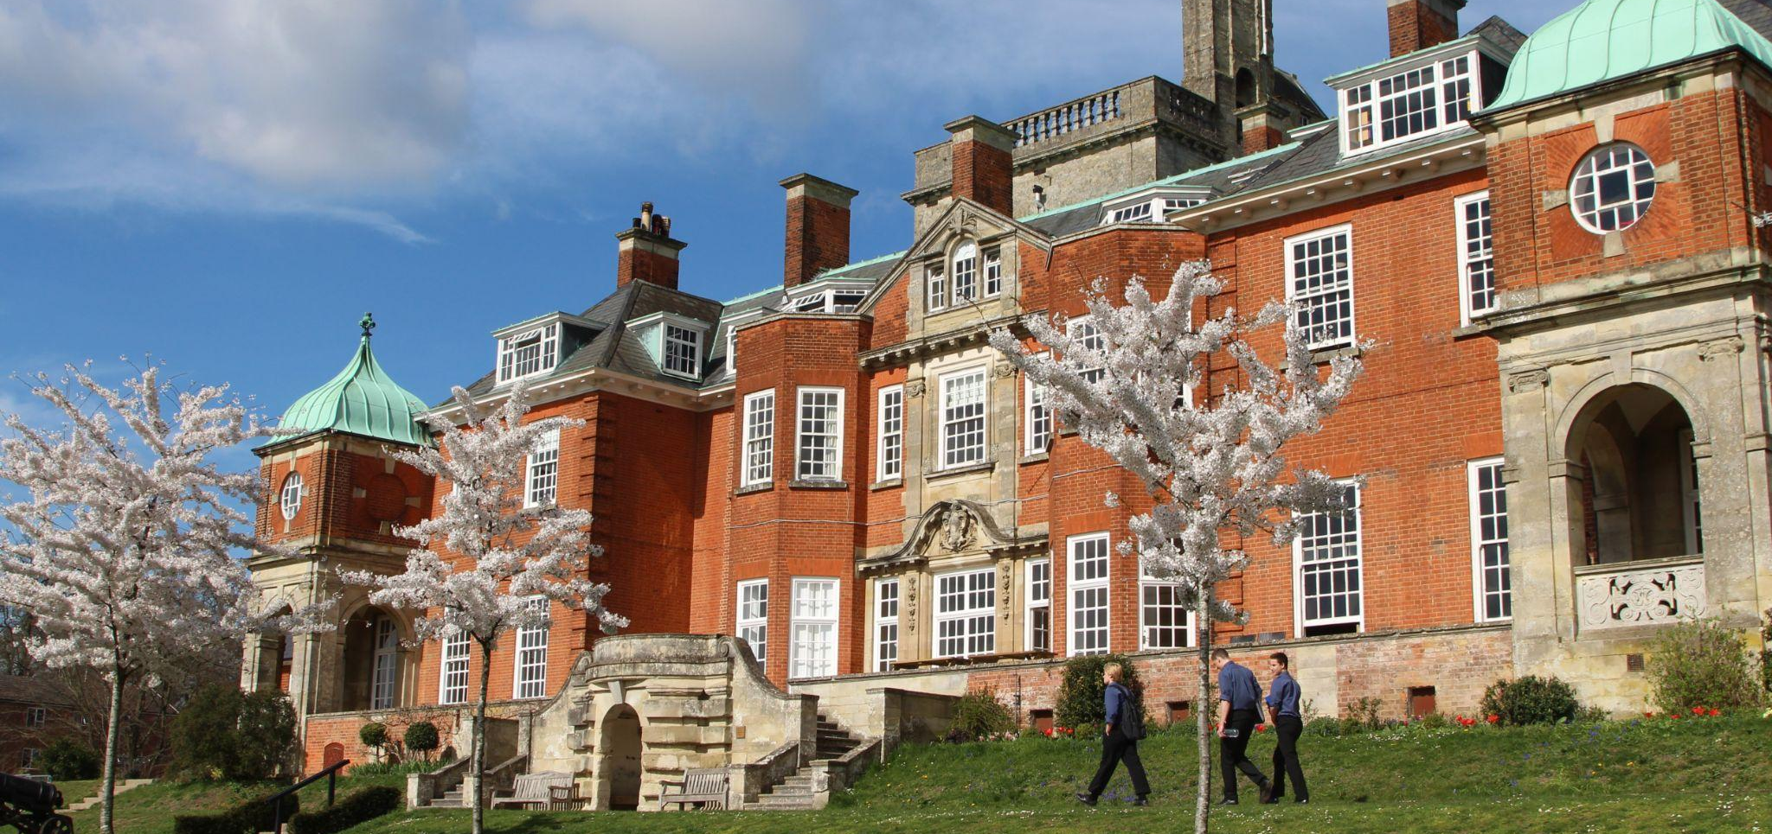
Pangbourne College
Pangbourne
Reading
Berkshire RG8 8LA
+44 (0)118 984 2101
pangbourne.com

